Slide 1
ONLINE VOTING SYSTEM
UNDER THE GUIDANCE OF :
POOJA MEHTA
SUBMITTED BY:
1. SAKTHI ROHINI
2. ANAND

Slide 2
INTRODUCTION
Online voting systems, often referred to as electronic voting or e-voting systems, represent a modern approach to the traditional process of casting votes in elections. These systems leverage the power of the internet to enable voters to participate in elections from remote locations, using various digital devices such as computers, smartphones, or tablets. This method of voting offers numerous advantages, including increased accessibility, convenience, and the potential for higher voter turnout. However, it also presents unique challenges, particularly in ensuring security, privacy, and the integrity of the electoral process.

Slide 3
PROJECT OBJECTIVE
The objective of this project is to develop and implement a secure, reliable, and user-friendly online voting system that enhances the electoral process by enabling eligible voters to cast their ballots remotely via the internet. This system aims to improve accessibility for all voters, including those with disabilities, those living in remote areas, and expatriates. By providing an intuitive user interface, the system will simplify the voting process and reduce errors. Robust security measures, including encryption and secure authentication, will protect against cyber threats, ensuring the integrity and confidentiality of the votes. The system will also be designed to be cost-effective and efficient, reducing the expenses associated with traditional voting methods and streamlining administrative processes. With transparency and scalability in mind, the system will support various election sizes and adhere to all relevant legal and regulatory requirements. Ultimately, this online voting system will facilitate higher voter participation and foster greater trust in the democratic process.

Slide 4
TECHNOLOGY USED
JAVA
Java is an object-oriented programming (OOP) language, which means it supports the principles and concepts of object-oriented programming.
Java
HTML
Angular
HTML, which stands for HyperText Markup Language, is the standard markup language used for creating and structuring web pages.
ANGULAR
Angular is a TypeScript-based framework that uses HTML, CSS, and JavaScript to build robust and scalable single-page applications.
Postman
POSTMAN
JAVASCRIPT
Postman is a popular collaboration platform and toolset used by developers to build, test, and document APIs
JavaScript is a widely used programming language primarily used for web development.

Slide 5
PROPOSED SYSTEM
The proposed online voting system aims to revolutionize the electoral process by providing a secure, accessible, and user-friendly platform for remote voting. This system will feature a responsive web application that voters can access via various devices, ensuring a seamless experience. Security is a paramount concern, with multi-factor authentication, encryption, and continuous monitoring to protect against cyber threats. The system will anonymize votes to maintain voter privacy and include robust audit and verification mechanisms to ensure transparency and trust. Additionally, the system will be designed to be accessible to all users, including those with disabilities, and offer technical support to assist voters. By streamlining voter registration, simplifying the voting process, and ensuring accurate vote counting, this online voting system aims to enhance voter participation and confidence in the democratic process.

Slide 6
REQUIRED SPECIFICATIONS
HARDWARE CONFIGURATION | SOFTWARE CONFIGURATION
Operating System : Windows 11 and above | Software IDE: Eclipse, Postman, MySQL, VS Code.
Hard Disk: 500 GB | Language: JAVA, Type Script, HTML, CSS
RAM: 16 GB | Front End: Angular, Boot Strap
 | Back End: Spring Boot, MySQL.

Slide 7
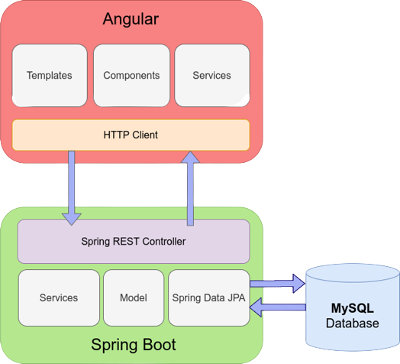
CONNECTION TO DATABASE

Slide 8
MODULES
01
ADMIN :
Registration and Login.
02
VOTER :
SignUp and Login.
03
ADMIN PAGE :
Add/Edit/Delete Party by Admin, List Voters, Result
04
VOTER PAGE :
Add Vote by Voter
Details About Online Voting System
05
ABOUT US :
06
CONTACT US :
Contact Details about Officers

Slide 9
SPRING NOTATATIONS
@Controller : | The @Controller annotation indicates that a particular class serves the role of a controller. Spring Controller annotation is typically used in combination with annotated handler methods based on the @RequestMapping annotation.
@Autowired | The @Autowired annotation provides more fine-grained control over where and how auto-wiring should be accomplished. Autowiring feature of spring framework enables you to inject the object dependency implicitly. It internally uses setter or constructor injection.
@RequestMapping | The @RequestMapping is one of the most common annotation used in Spring Web applications. This annotation maps HTTP requests to handler methods of MVC and REST controllers.
@Entity | The @Entity annotation specifies that the class is an entity and is mapped to a database table.

Slide 10
SPRING NOTATATIONS
@PutMapping | The @PutMapping is used for update the records.
@PostMapping | The @PostMapping is used to create a resource Mapping.
@GetMapping | The @GetMapping is used to read all the inserted records.
@DeleteMapping | The @DeleteMapping is used to delete the records.
@PathVariable | The @Path Variable annotation is used to extract the value from the URL.

Slide 11
SPRING NOTATATIONS
@Request Body | The @RequestBody annotation is applicable to handler methods of spring controller. spring should deserialize a request body into an object.
@ExceptionHandler | The @ExceptionHandler is an annotation used to handle the specific exceptions and sending the custom responses to the client.
@RestControllerAdvice | A controller advice allows you to use exactly the same exception handling techniques but apply them across the whole application, not just to an individual controller. You can think of them as an annotation driven interceptor.

Slide 12
CONCLUSION
In conclusion, the implementation of an online voting system represents a significant advancement in the way elections are conducted, offering numerous benefits such as increased accessibility, convenience, and potential cost savings.
By leveraging modern technology, the system can make voting more accessible to diverse populations, including those with disabilities and those living in remote areas or abroad.
The incorporation of robust security measures, such as multi-factor authentication, encryption, and continuous monitoring, ensures the integrity and confidentiality of the electoral process. Additionally, features like anonymized voting and comprehensive audit mechanisms help build public trust and transparency.
While challenges such as ensuring equitable access and preventing cyber threats remain, a well-designed online voting system can address these issues effectively.
Ultimately, this innovative approach can enhance voter participation and confidence, supporting a more inclusive and efficient democratic process.

Slide 13
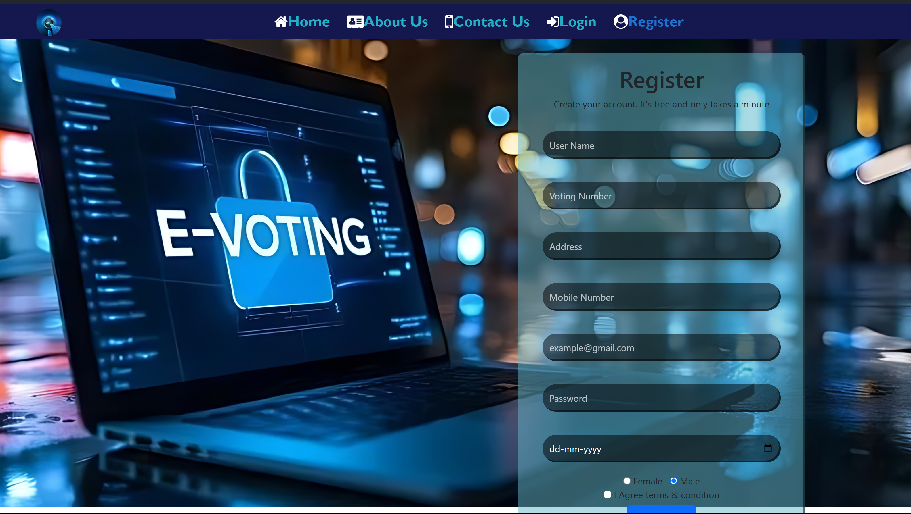
REGISTRATION PAGE

Slide 14
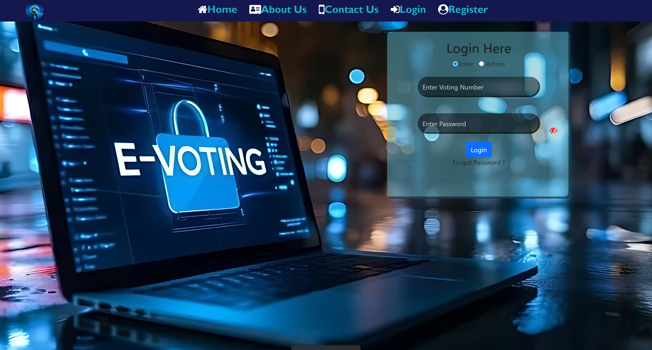
LOGIN PAGE

Slide 15
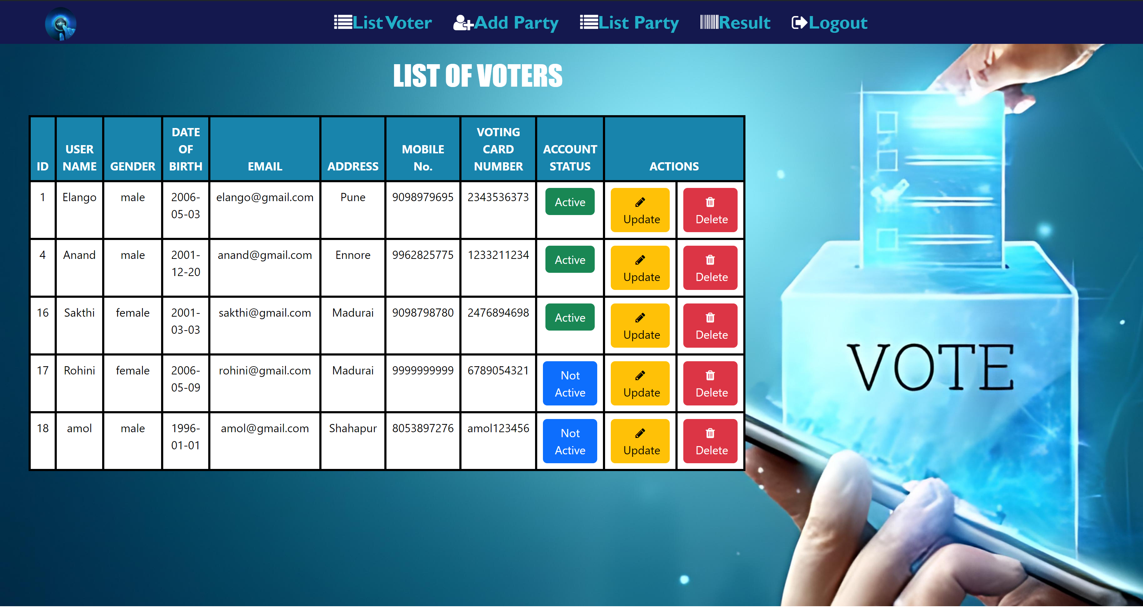
LIST VOTERS

Slide 16
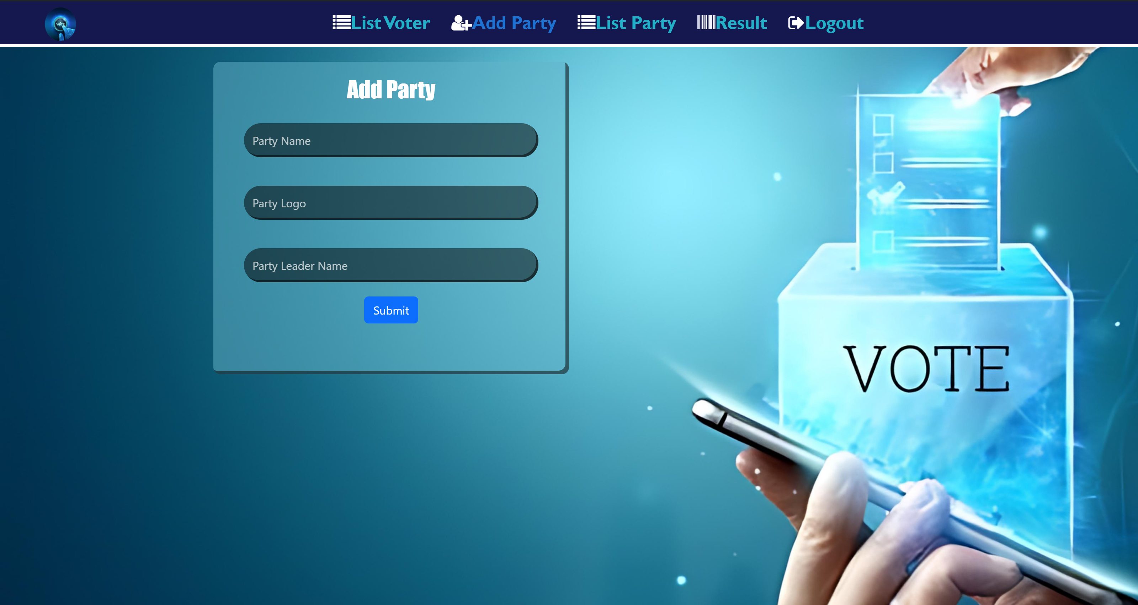
ADD PARTY

Slide 17
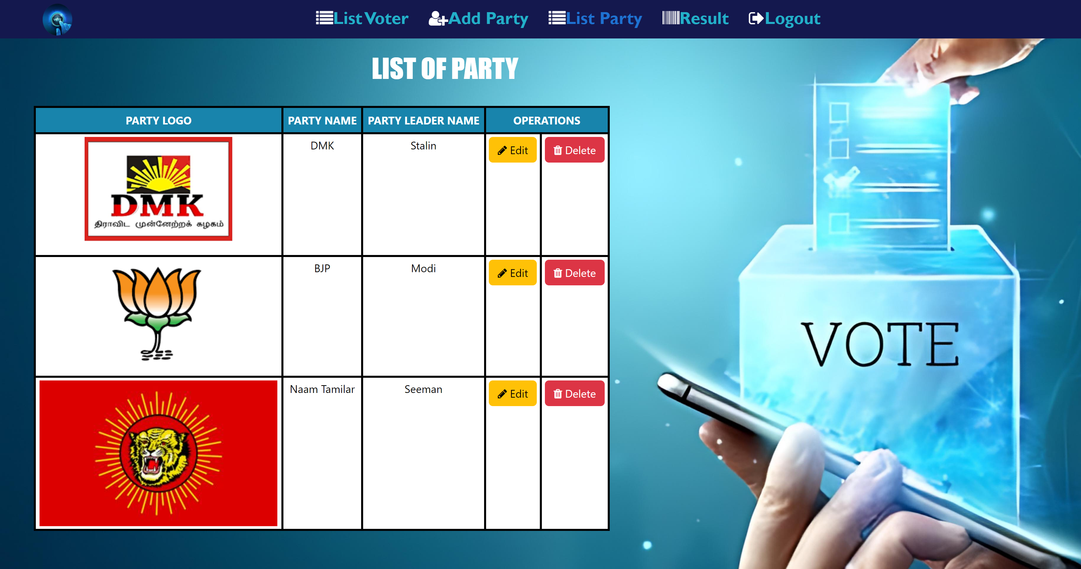
LIST PARTY

Slide 18
THANK YOU

